Slide 1

Scikit-learn
Philosophy, new stuff and roadmap
Andreas Müller
Scikit-learn core developer
Principal Engineer @ Microsoft
Notes:
Hi, I’m Andreas Mueller. I’m grateful for the opportunity to talk to you today about my work here at the DSI, and about Open Source for Science and Data Science.
I’m an Associate Research Scientist, and I mostly work on open source software for machine learning, in particular the scikit-learn library.
My talk will have two parts: first, I want to talk a bit about the importance of software for science, and the scientific python ecosystem.
Then I’ll talk more about the particular project I’m working on, scikit-learn, and my group here at Columbia.

Slide 2

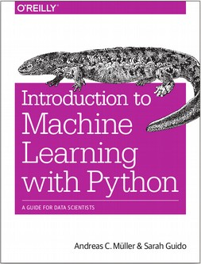




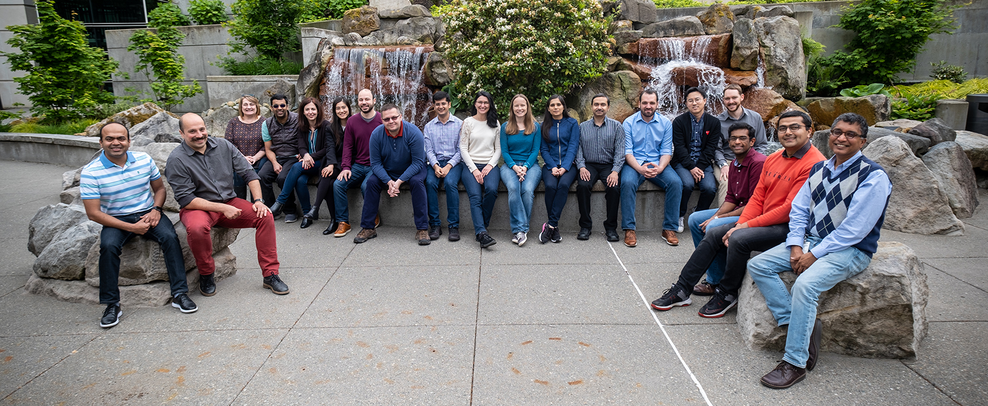
Gray System Labs
(Seattle, Madison, Bay)
Notes:
Very briefly some background on myself. I did my PhD in Machine learning at the University of Bonn in Germany. Then I worked for the Amazon Machine Learning Research lab in Germany in Berlin. During my PhD I had started contributing to open source, and I couldn’t really do that well while at Amazon.
I was then lucky to get a position at NYU as a Research Engineer as part of the moore-sloan data science environment, where I continued my open source work and also co-authored this book about machine learning with python.
After two years at NYU I moved to the DSI, first as lecturer and now as Associate Research Scientist.

Slide 3
Machine Learning with Python and Scikit-learn
Notes:
Scikit-learn, as I said, is part of the scientific python ecosystem. It’s the main tool to do machine learning within this ecosystem, and arguably the most popular tool to do machine learning overall.
Scikit-learn is a tool focused on supervised learning, but also includes unsupervised learning, preprocessing, model selection, model evaluation and other tools around the machine learning process.

Slide 4
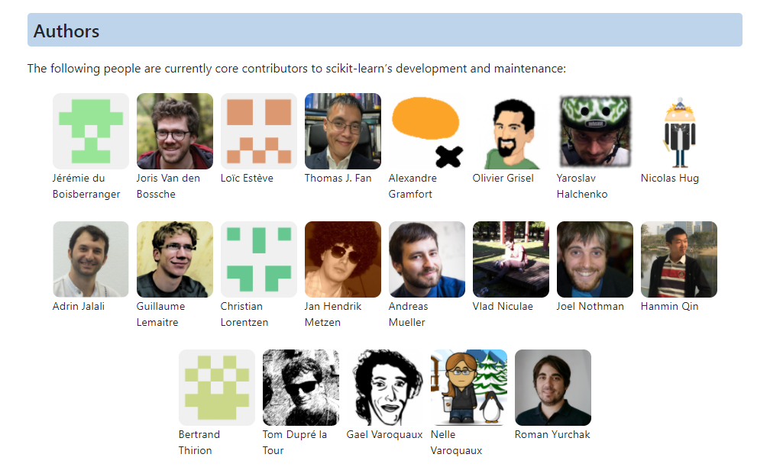
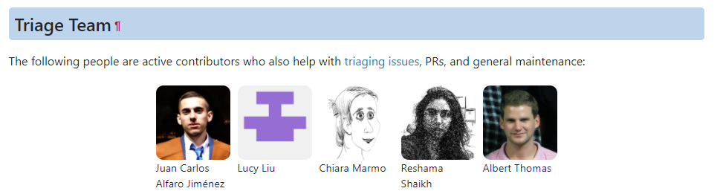
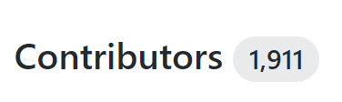
Emeritus
Core Developers
Alexander Fabisch
Alexandre Passos
Angel Soler Gollonet
Arnaud Joly
Chris Gorgolewski
David Cournapeau
David Warde-Farley
Eduard Duchesnay
Fabian Pedragosa
Gilles Louppe
Jacob Schreiber
Jake Vanderplas
Jaques Grobler
Jarrod Millman
Kyle Kastner
Lars Buitinck
Manoj Kumar
Mathieu Blondel
Matthieu Brucher
Noel Dawe
Paolo Losi
Peter Prettenhofer
Raghav Rajagopalan
Robert Layton
Ron Weiss
Satrajit Ghosh
Shiqiao Du
Thouis (Ray) Jones
Vincent Dubourg
Vincent Michel
Virgile Fritsch
Wei Li
Notes:
The project was started around 2010 by a team working on Neuroscience at INRIA in Paris, and that team is still very involved. For example Alex Gramfort, Olivier Grisel, Bertrand Thiron and Gael Varoquaux are among the original authors.
There is currently 19 core developers, with a long list of past contributors. In total the project has had contributions from over 1,300 developers, including researchers from at least 34 US universities.
I have been contributing to the project for about 8 years.
Both I and INRIA have people working on the project on the clock, but a lot of the contributions are done by people in their free time.

Slide 5
Our Mission:
Commoditize and Democratize Machine Learning
Notes:
The mission of scikit-learn is to commoditize and democratize machine learning.
We want to enable everybody to use machine learning and data science. We want to make it easy, and we want to make it easy to do it right.
We are not at the cutting edge of machine learning research, we are building tools that actually work, and work robustly, and are well documented and easy to use.
And I would say we’ve been quite successful.

Slide 6
Guiding Ideas

Slide 7
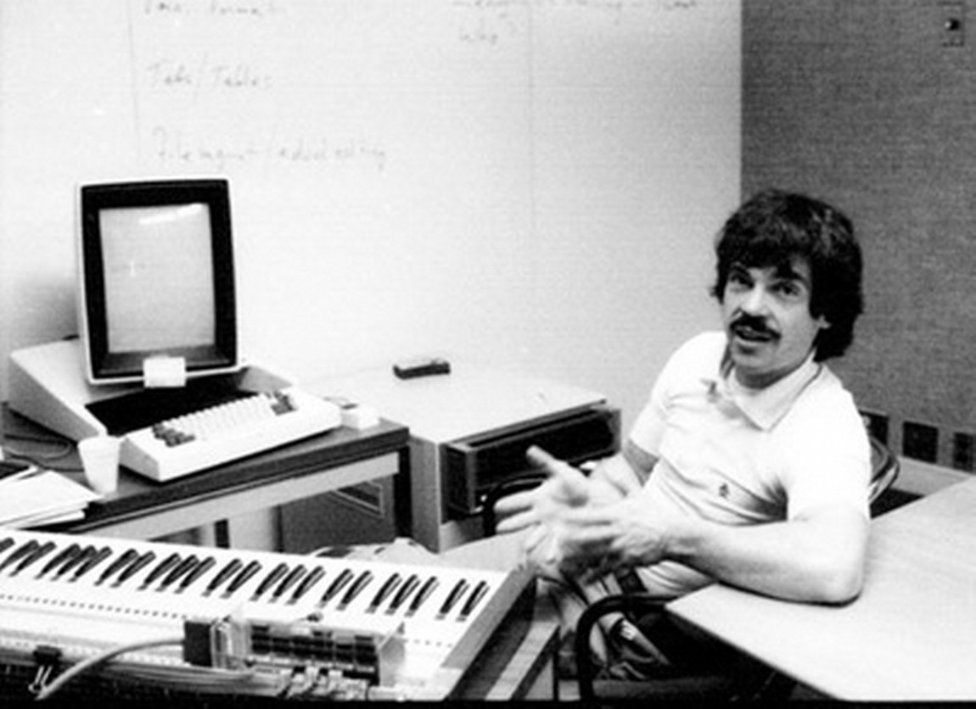
Simple things should be simple,
complex things should be possible.
Alan Kay
Notes:
There is this nice quote here by alan kay, which says “simple things should be simple, complex things should be possible”. Whenever I think about a new feature or a new api, I keep that in mind. When in doubt, in scikit-learn we err on the side of keeping simple things simple, sometimes sacrificing some of the power of more complex designs. But I’ll talk about that more later.

Slide 8
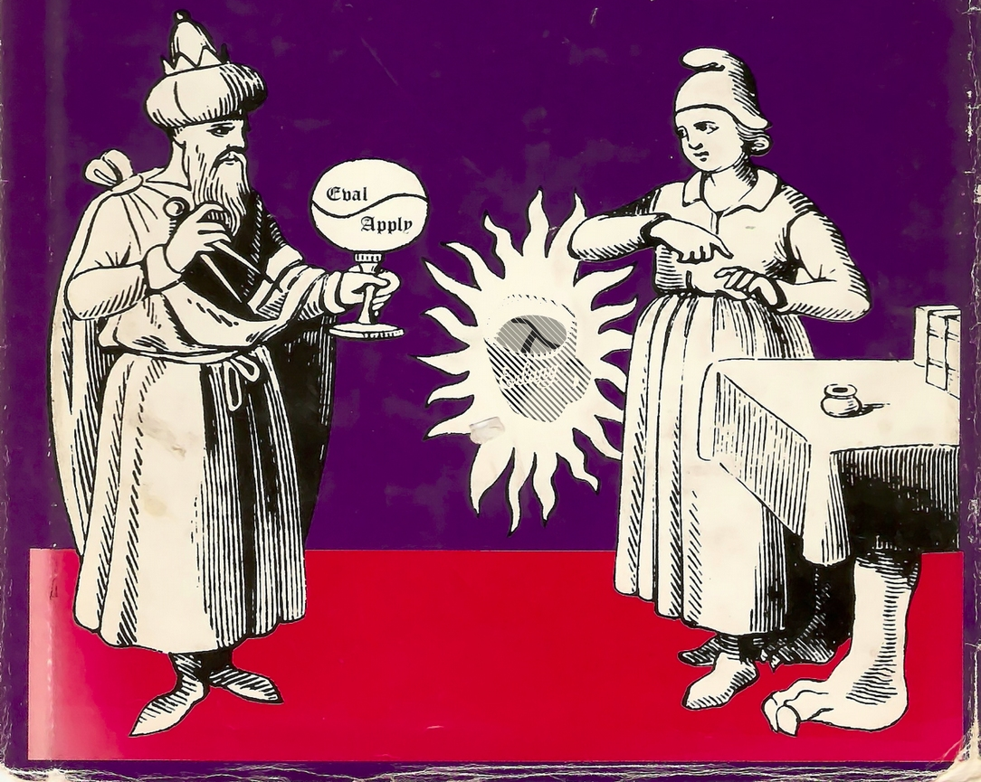
Programs should be written for people to read,
and only incidentally for machines to execute.
Harold Abelson
Notes:
Maintainable code is easy to read and understand for someone new to the code base. You should keep in mind this classic quote from the classic wizzard book.

Slide 9

avoid code;
avoid code rot!
Notes:
One of the easiest way to keep a project maintainable is to avoid code. I really don’t like code, and I like to delete as much of it as I can. Some people really love writing long and complex code. But some day some poor soul has to read that and understand it. Every time you add a new feature, you add more complexity, and more moving parts to a project. Stop writing so much code, and start deleting more code. For every feature you add, ask yourself: is this worth the added burden for my future self, maintaining this code to the end of time?

Slide 10
Recent Additions and Improvements
Notes:
I think that’s enough bragging, so I want to talk a little bit more about what my team is currently working on.
A lot of the work we do is quite technical and I don’t want to go into the details too much. Much of it is maintenance, bug fixes and usability improvements, which are crucial, but don’t make for a great presentation. Instead I want to talk about some more visible highlights.

Slide 11
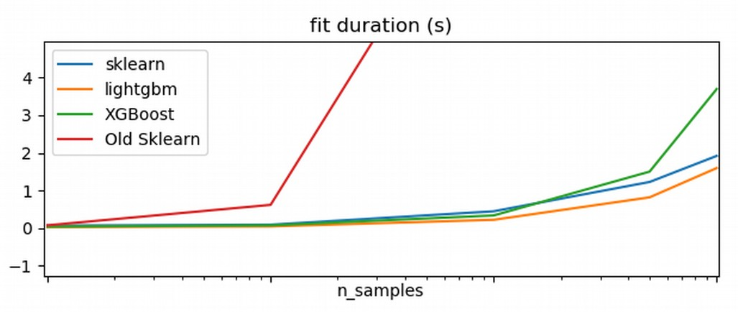
Histogram Gradient Boosting
Already: missing value support.
Categorical variable support in next release (December)!
Still in the works: sparse matrix support, quantile loss.
Notes:
One of the recent additions by my team is an implementation of extreme gradient boosting by Nicolas Hug. This is much, much faster than what was in scikit-learn before and it will have a huge impact on the ML community.
You can see here that it’s comparable to two existing tools, xgboost and lightgbm. LightGBM was released by microsoft and it’s quite great, but by including our own implementation into scikit-learn, we make it available to a much wider audience.

Slide 12
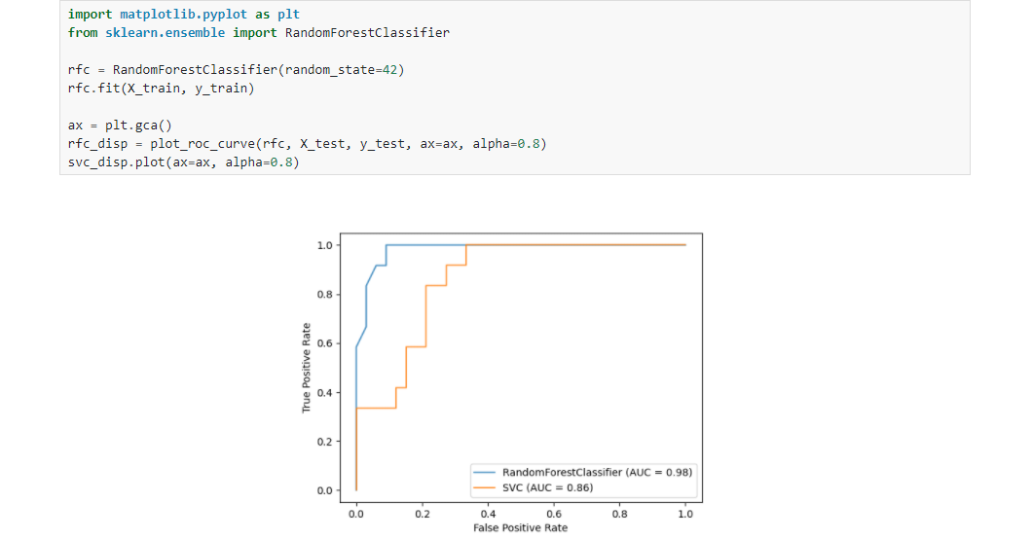
Visualization
So far:
ROC & PR Curve
Confusion matrix
Decision trees
Partial dependence
More to come,
Help wanted!
Notes:
One of the other areas that we’re working on is visualization. We’re adding new visualization tools to scikit-learn, to make common visualizations more easy to produce. We’re also building new tools that automatically create relevant and informative visualizations for machine learning tasks.
I think the human in the loop in data science is very important and I want to make it as easy as possible for the user to look at the data in different ways.
Tufte said there’s no reason not to look at the data.

Slide 13
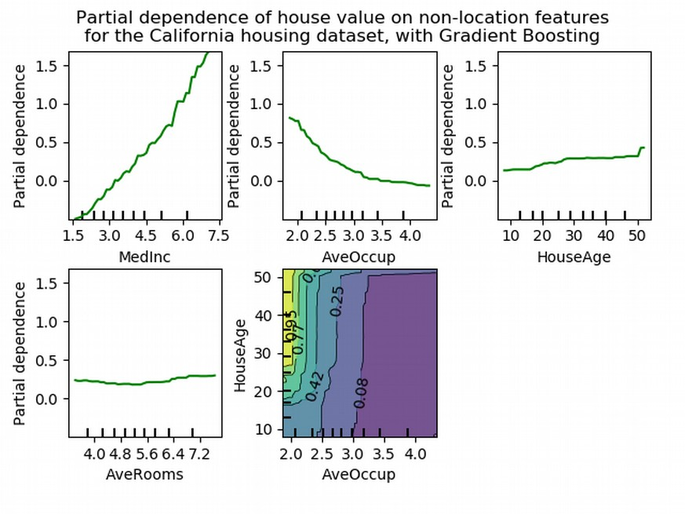
Model understanding and inspection
Notes:
Related to visualization is model understanding and inspection.
We’re building tools that allow users to validate and debug their models, and understand their data better.
This allows our users to better judge when and why their model might work or fail, or how to improve data quality and data collection.

Slide 14
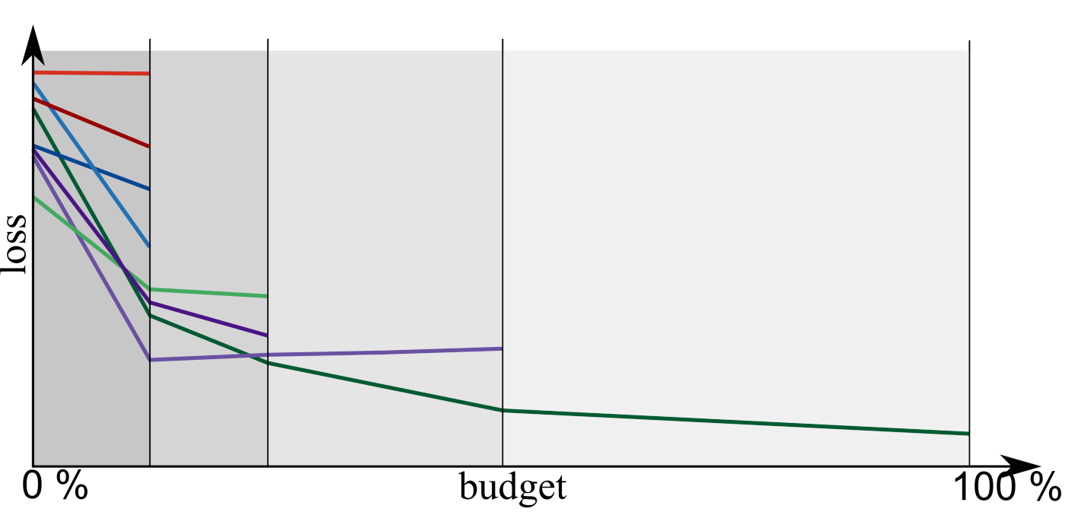
Successive Halving
In upcoming release!

Slide 15
Estimator Tags
est._get_tags()
input_validation
multioutput
multilabel
stateless
missing_values
...

Slide 16
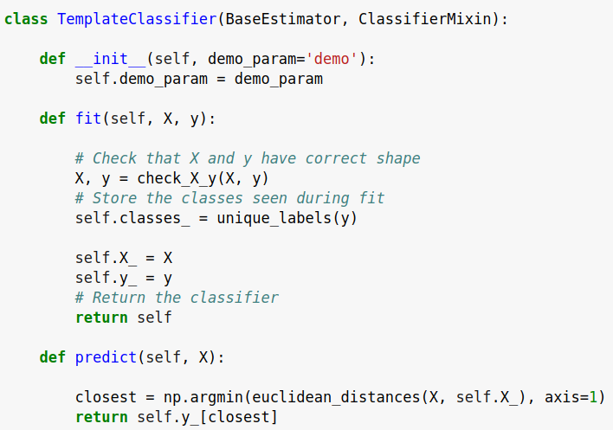
check_estimator
AssertionError: Error message does not include the expected string: 'fit'.
Observed error message: "'TemplateClassifier' object has no attribute 'X_'"

Slide 17
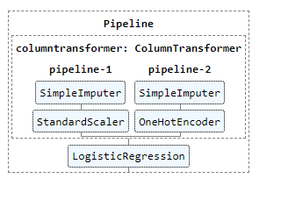
Also see: release highlight examples!
https://scikit-learn.org/dev/auto_examples/release_highlights/
0.22:
Decision Tree Pruning
Multi-class ROC AUC
KNNImputer
Permutation Importance
Stacking
0.23:
Generalized Linear Models
Pipeline graph diagrams
Keyword only arguments
No more SVC(2, ‘poly’, 5, .1)!

Slide 18
Upcoming 0.24
Categorical variable support in Histogram Gradient Boosting
Sequential Feature Selection
Individual Conditional Expectation (ICE)
Missing value support in OneHotEncoder
So much more…. https://scikit-learn.org/dev/whats_new/v0.24.html

Slide 19
Outside Scikit-learn
Notes:
I think that’s enough bragging, so I want to talk a little bit more about what my team is currently working on.
A lot of the work we do is quite technical and I don’t want to go into the details too much. Much of it is maintenance, bug fixes and usability improvements, which are crucial, but don’t make for a great presentation. Instead I want to talk about some more visible highlights.

Slide 20
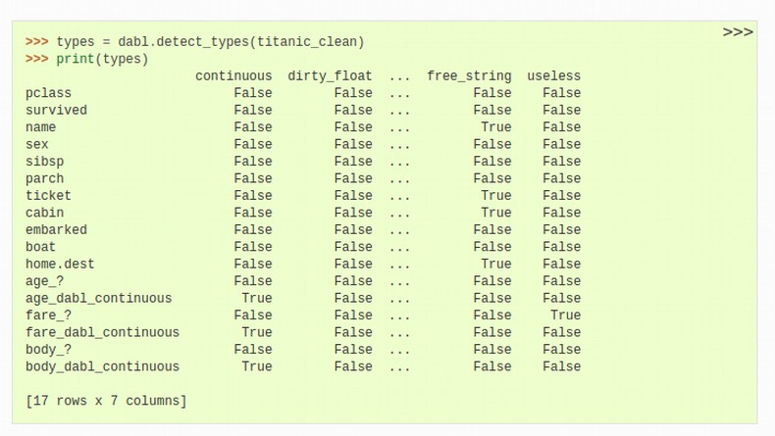
AutoML & dabl
sc = SimpleClassifier()
sc.fit(data, target_col=”survived”)
ac = AnyClassifier()
ac.fit(data, target_col="survived")
Notes:
Finally, we’re working on tools build on top of scikit-learn for more automated machine learning.
What we’re trying to automate is parameter tuning and selecting the right algorithms. These are things that are actually fairly easy to automate to some degree.
The hard part in machine learning is collecting and preparing the data and understanding the interaction between data and model. So we’re automating one part, but the goal is to enable the user to iterate more quickly on other aspects. I want the human in the loop, but I don’t want the user to waste their time tuning parameter. I want them to interpret the results.
So dabl tries to create an interactive loop in which the user can spend their time where it matters, looking at the data and looking at the model, not tuning it.

Slide 21
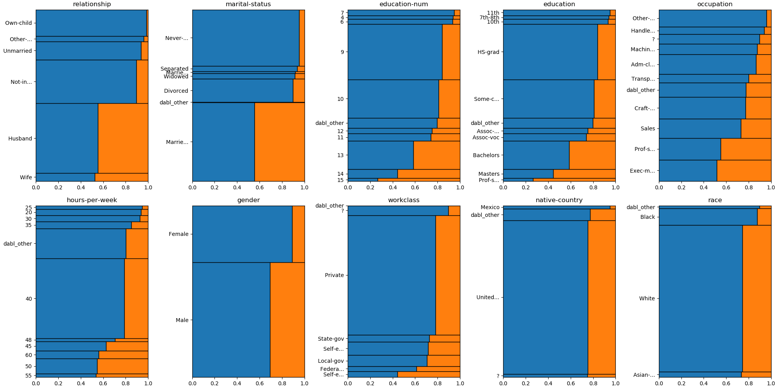
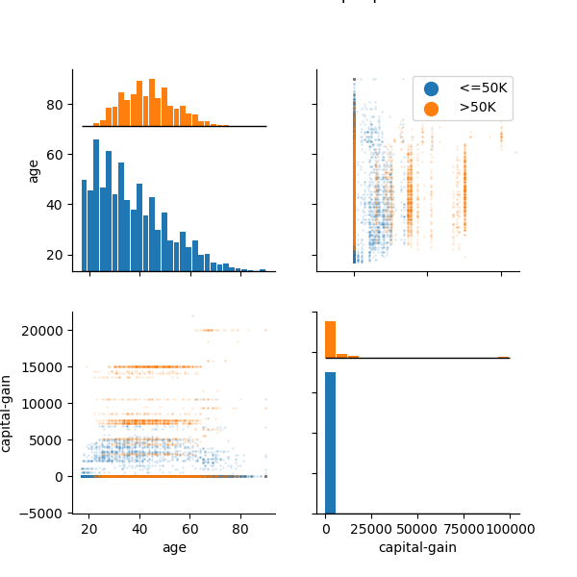
dabl.plot
data = pd.read_csv("adult.csv")
plot(data, 'income’)

Slide 22
Portfolio creation
Run Hyper-parameter optimization across models on large benchmark suite (OpenML-CC18)
Evaluate all final models across all datasets
Greedily create portfolio of best-performing, diverse models
“Practical Automated Machine Learning
for the AutoML Challenge 2018” Feurer et. al.

Slide 23
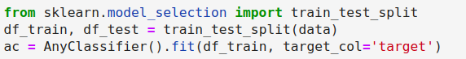
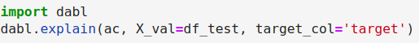

Slide 24
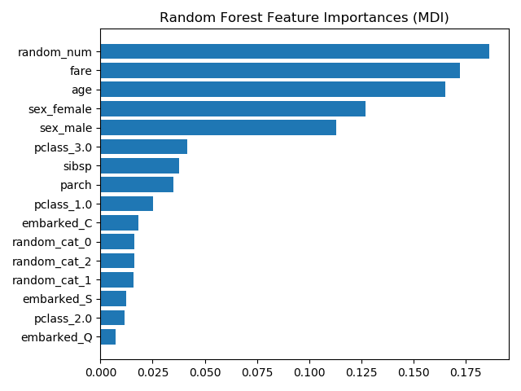
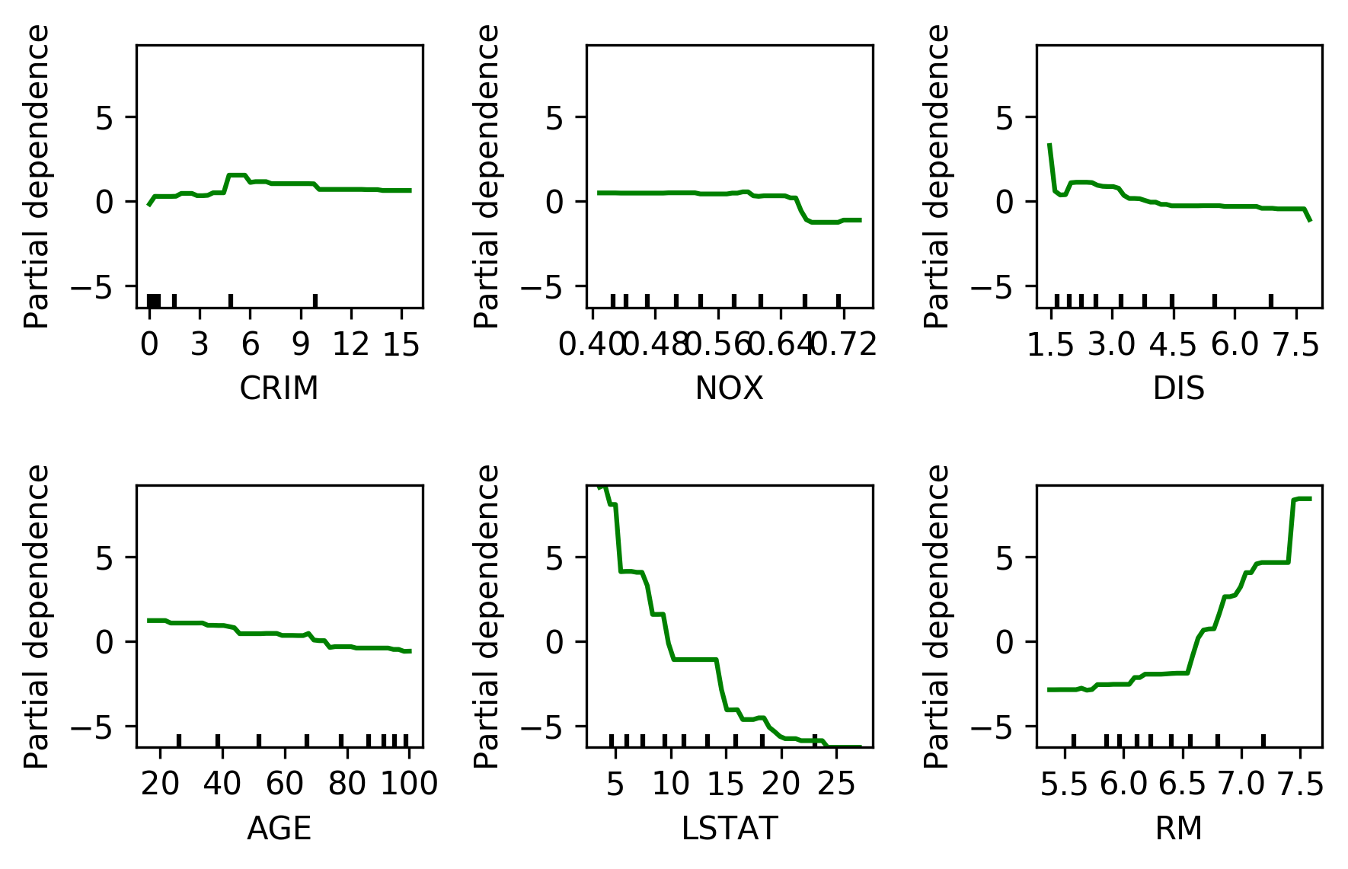
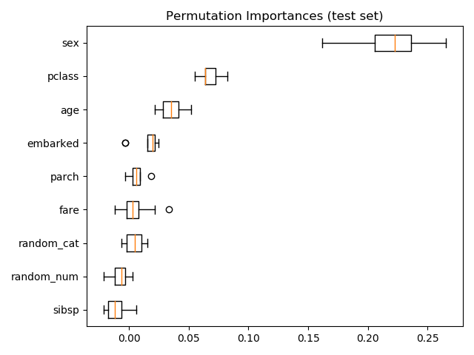
Model Explanation

Slide 25
Current Work
See https://github.com/scikit-learn/enhancement_proposals/
For API discussions (SLEPS)
Notes:
I think that’s enough bragging, so I want to talk a little bit more about what my team is currently working on.
A lot of the work we do is quite technical and I don’t want to go into the details too much. Much of it is maintenance, bug fixes and usability improvements, which are crucial, but don’t make for a great presentation. Instead I want to talk about some more visible highlights.

Slide 26
Pandas & Feature Names
https://github.com/scikit-learn/enhancement_proposals/pull/37
Probably: allow returning of pandas dataframes and xarray arrays in all transformers / pipelines.
Main goal: allow inspection of features in pipelines etc.

Slide 27
Data API Consortium and NEP 37
https://data-apis.org/
https://numpy.org/neps/nep-0037-array-module.html
Using any numpy-like or pandas-like library as compute backend! (mxnet, CuPy, modlin, dask, ….)
…. except for Cython code…

Slide 28
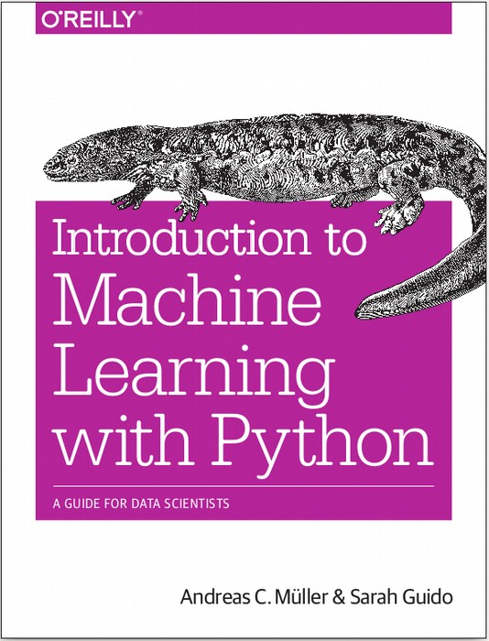




amueller.github.io
@amuellerml
@amueller
andreas.mueller
@columbia.com
Notes:
Thank you for your attention and I’m happy to take any questions!

